Slide 1



HUSKY
SNIFFS
Because Huskies always find what’s lost.

Slide 2


LET’S SEE WHAT THE HUSKIES THINK ABOUT THE LOST AND FOUND PROCESS

Slide 3
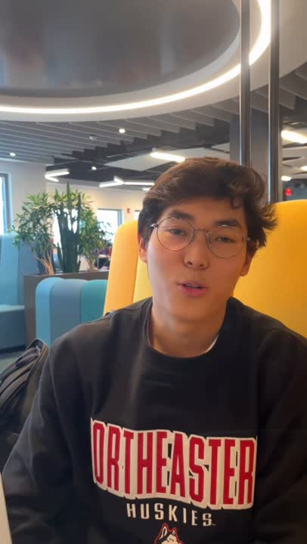

HuskyCam

Slide 4

BRAIN BEHIND THE BUILD
PURVANG KHONDE

Slide 5





UNDER THE HOOD

Slide 6





STAR FEATURES
SERVICE 02
CLAIM VERIFICATION
AI-POWERED LOST & FOUND MATCHING
INTERACTIVE CAMPUS MAP PICKER
IN-APP CHAT WITH SMART PROMPTS

Slide 7


FROM LOST TO FOUND
Student
lost item
Student
founditem
01
02
Login / Authentication
Access Student Dashboard
Report Lost/Found a Item
View Lost Items History
AI match
chat
claim
Login / Authentication
Access Student Dashboard
Report Lost/Found a Item
View Lost Items History
chat
verify claim

Slide 8
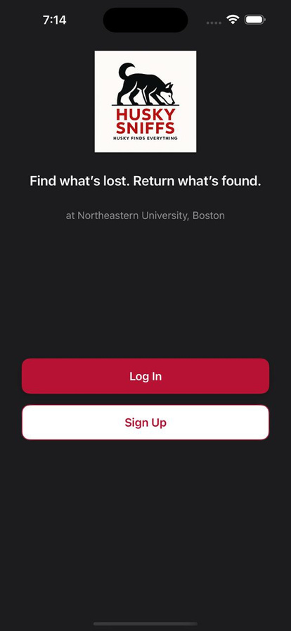
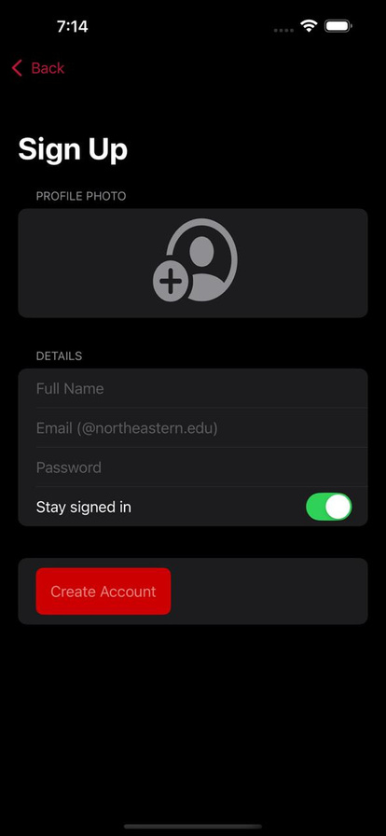
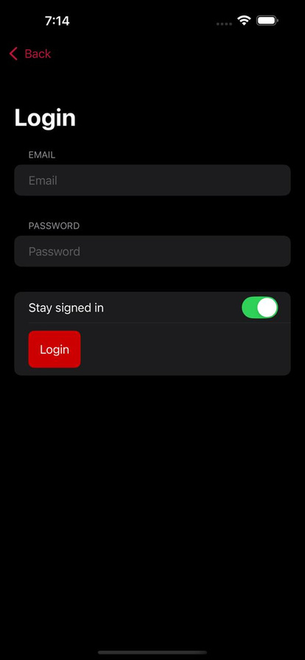
USER FLOW

Slide 9
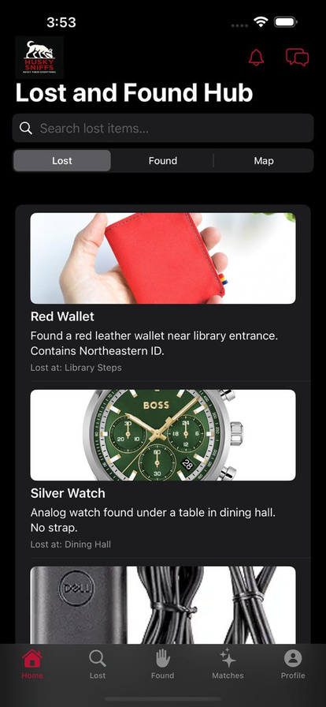
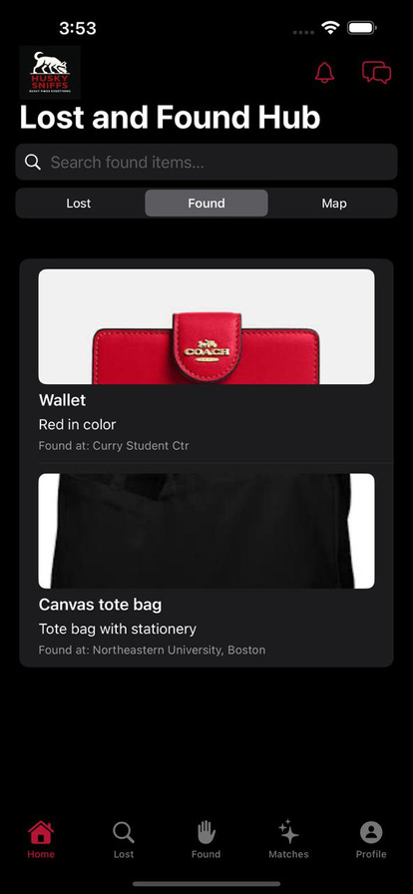
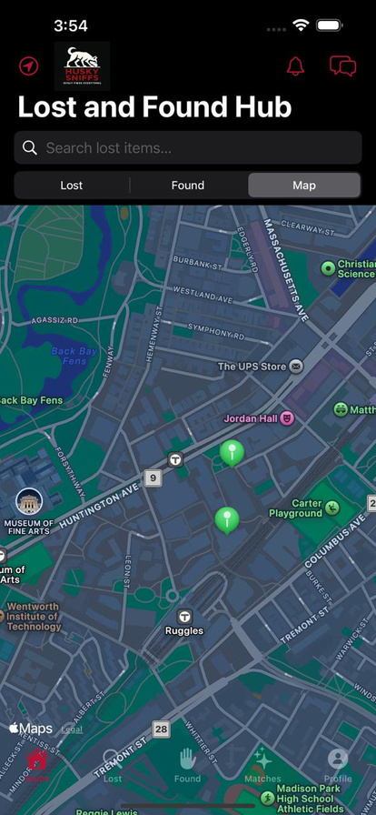
USER FLOW

Slide 10
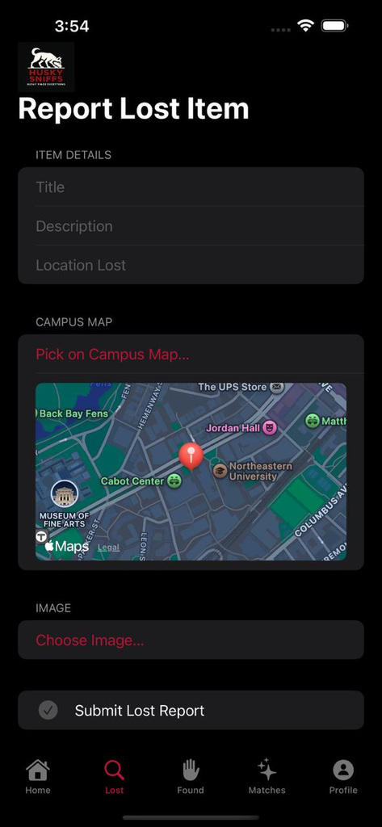
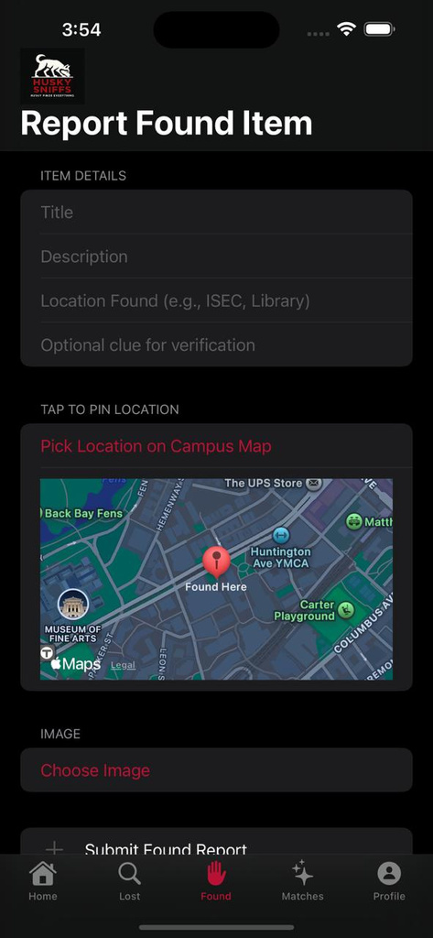
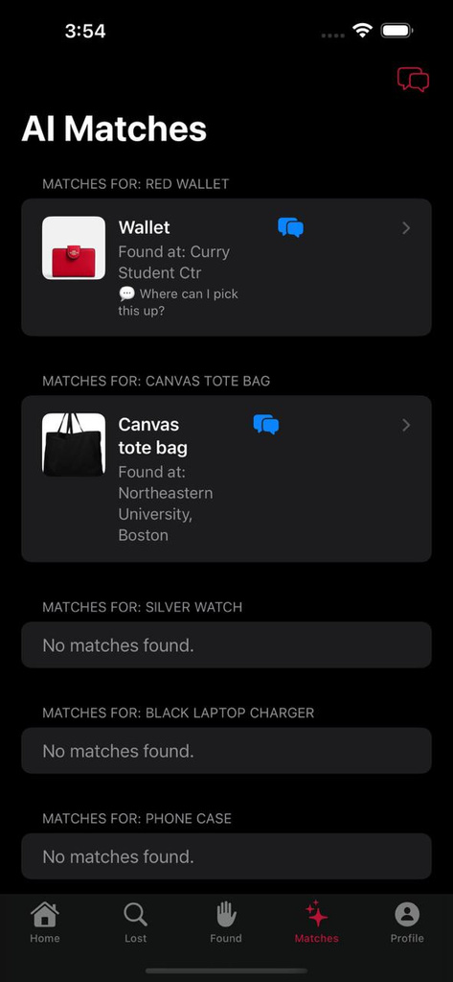
USER FLOW

Slide 11
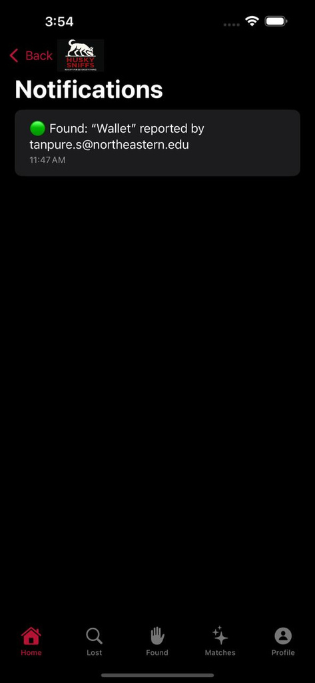
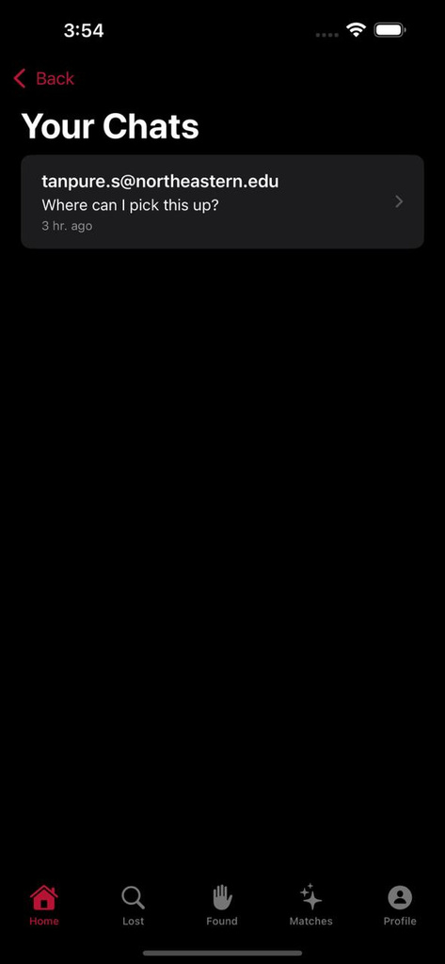
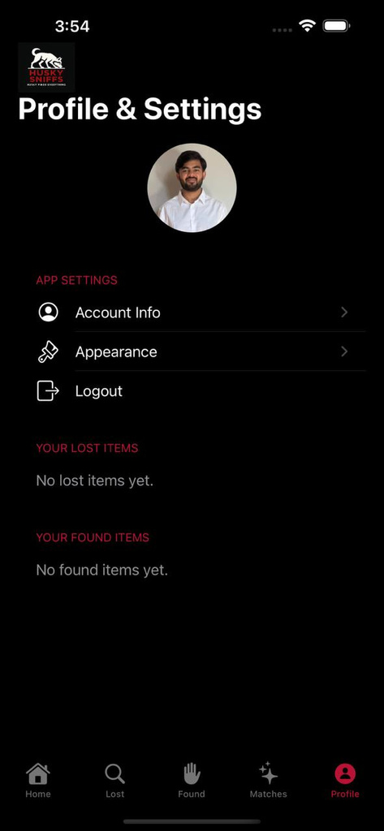
USER FLOW

Slide 12



FUTURE PLAN
Email Services SMTP Integration
Use AI Model to render closest location
Think more about supervisor adding a lost item

Slide 13
LET’S SEE WHAT THE HUSKIES HAVE BEEN TRACKING !

